Slide 1


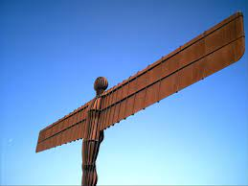
Sculpture Skills, Paul Carney
Enjoy read Paul’s blog on Sculpture first and then try these activities with your students.
Sculptors use skills & techniques including cutting, joining, shaping, moulding, forming, bending, folding, stitching, welding, bolting, tying, weaving, and balancing to construct sculptures from a wide variety of materials and found objects. In this way, many of the tools and techniques we use in Design Technology overlap with those we need for sculpture. As a former Design Technology teacher, I can’t see any reason why sculpture cannot overlap with some of your primary DT requirements. The skills being utilised in both disciplines are often arbitrary.

Slide 2
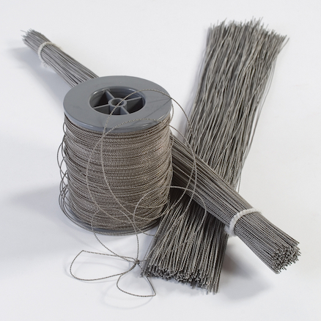
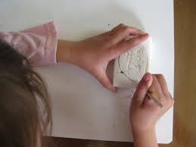
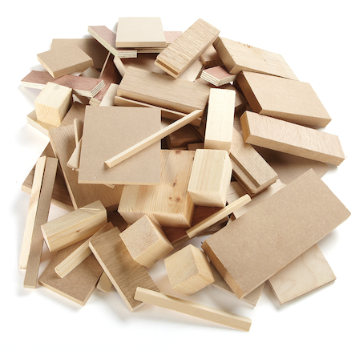
Sculpture Skills
Given the right opportunities however, sculpture is a great place to develop gross motor skills. Through sculpture we can bend wire, or cut, shape and form wood, or carve soap or modelling materials on larger scales. We could make kinetic sculptures or make sculptures that involve our whole bodies and senses. The more ways you can involve whole arm and body movements, the more you will involve gross motor skills which will level the gender playing field. Simply getting the pupils to stand up while working is also a great way to do that because pupils will automatically incorporate whole body actions to work.

Slide 3
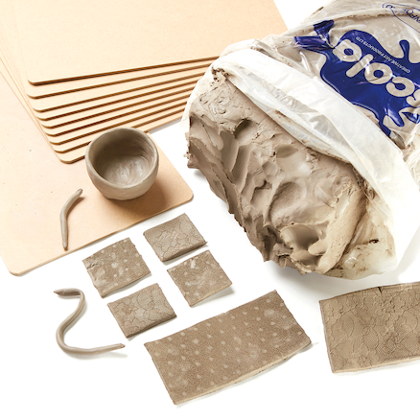
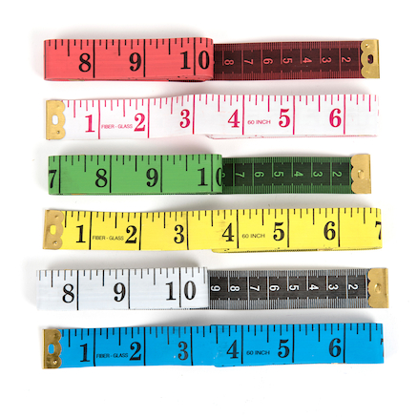
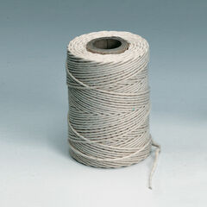
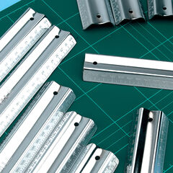
Skill 1: Measuring
Measure - mark out, and score precisely.
You will of course need rulers for this, but you may use tape measures or even string to measure human proportions or distances for example, or compasses to create geometric patterns such as the Flower of Creation on soft surfaces such as clay or plasticine that they could carve, then make plaster casts from.

Slide 4
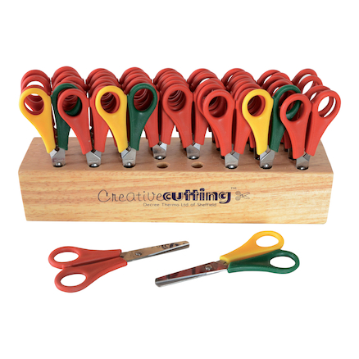
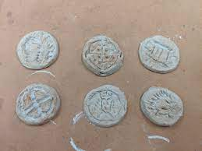
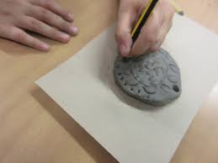
Skill 2: Cutting
Cut - using scissors, knives, to engrave, carve, and hollow.
Cutting skills are an important fine motor skill development of course and you can find plenty of scissor cutting activities by simply searching on the internet. There is a great range of scissors at TTS ideal for making collages, cutting patterns and shapes in creative ways. Interestingly, cutting a square is a more complex fine motor skill than cutting a circle, because it demands complete changes of direction, whereas cutting circles is a gradual, smooth movement using small, incremental changes.
If you’re using craft knives , you’ll need cutting mats and sharp blades, because blunt blades cause accidents. I usually use them from around year 4 onwards and incorporate plenty of health and safety guidance into my teaching. You’ll also need to use steel rulers instead of plastic ones when cutting straight lines.
To engrave, carve or hollow forms you can use craft modelling tools and air-dry or natural clay, even modelling clays. Why not cut large circles from clay to make coins then have the children design Roman, Greek, or Anglo-Saxon style coin designs?

Slide 5

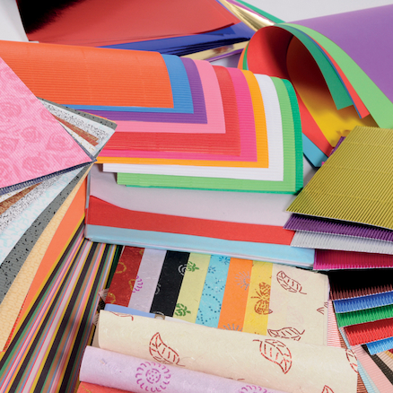
Skill 3: Shaping
Shape and form - fold, bend, mould, model, roll, pinch, press, knead, scrape, pour, and squash.
These are fine motor skills that build from Early Years so continuity is important to build on the important foundation stage. You can create lots of paper folding and paper engineering activities for any age; origami or pop-ups being the most common, and there is a great range of craft papers available at TTS to do this.

Slide 6
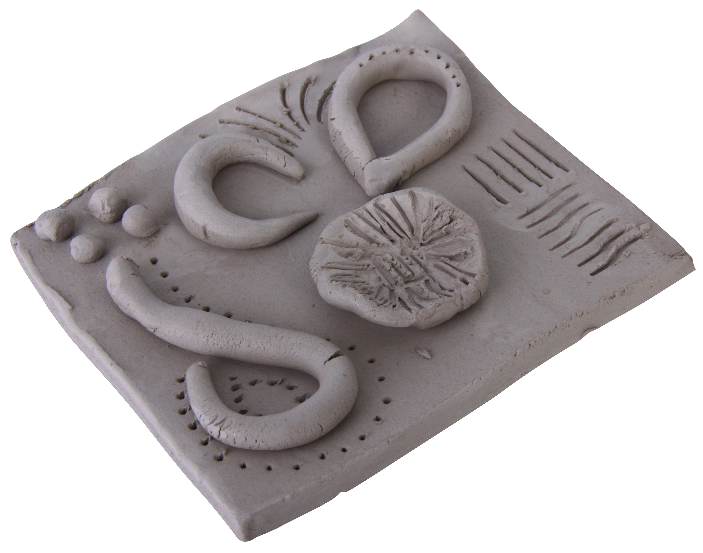
Skill 3: Shaping continued
Shape and form - fold, bend, mould, model, roll, pinch, press, knead, scrape, pour, and squash.
Clay and modelling materials will also help develop your pupils’ ability to mould, model, pinch and press when making small-scale models. I see a lot of closed tasks on social media when making models - dragon’s eyes, or animals for example. These ‘follow-me’ type activities will certainly raise skills, but don’t do a great deal for imagination. If you decide on a core skill, such as rolling a slab of clay, you can challenge the children to use their imaginations to develop it in numerous ways. The slab might be on an architectural theme for example, and they could design their own house, castle, or fantastic place. The slab might be portrait led and so they could create their own face or choose a famous person to create. In this way, they are learning a skill through the same ‘follow-me’ approach but utilising that skill creatively and independently.

Slide 7
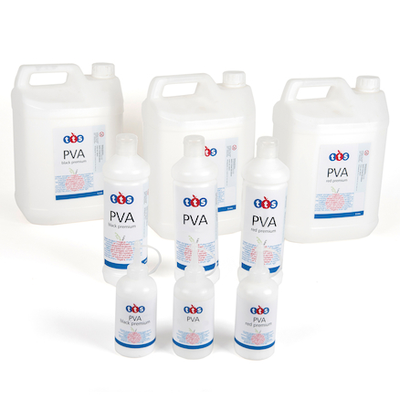
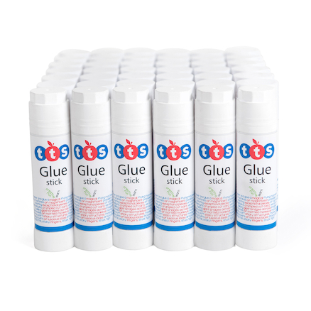
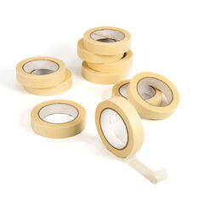
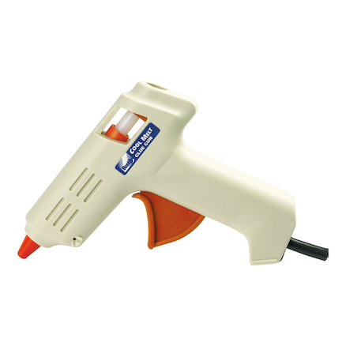
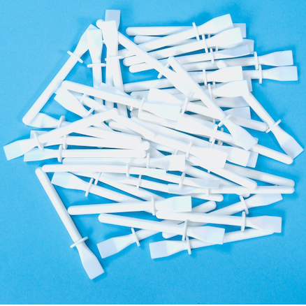
Skill 4: Joining and Combining
Join and combine - stick, glue, tape, knit, sew, weave, and twist.
Glue was always a huge issue for me in my art departments. I used a lot of PVA of course, but I used the better-quality stuff that was strong bonding, yet washable, rather than the budget types which didn’t stick as well and are a false economy. I would store it in mini plastic containers with lids, and use glue spreaders because pupils would get confused if I used glue brushes and then use them for painting. Glue sticks were a must buy of course and I’d also have plenty of glue guns and glue sticks to use for modelling. Use the cool ones for added safety.
Masking tape was always a staple in the department of course, but again, I’d try to buy better quality tape because it just works so much better.

Slide 8
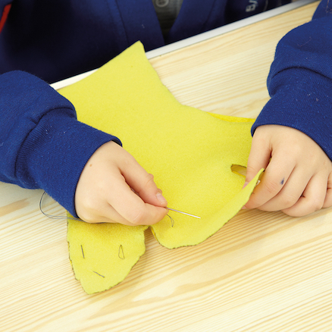
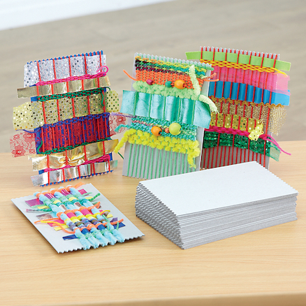
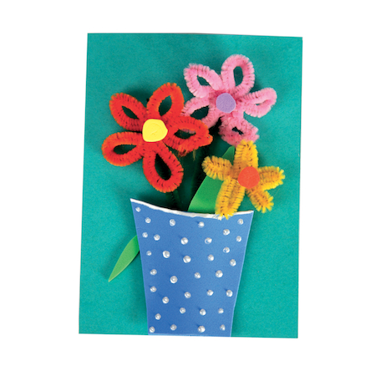
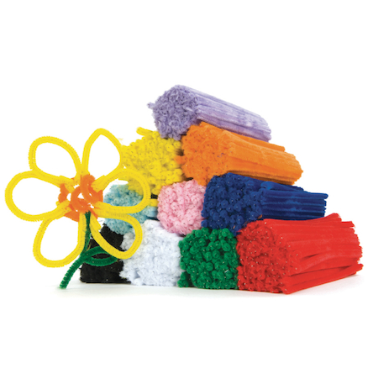
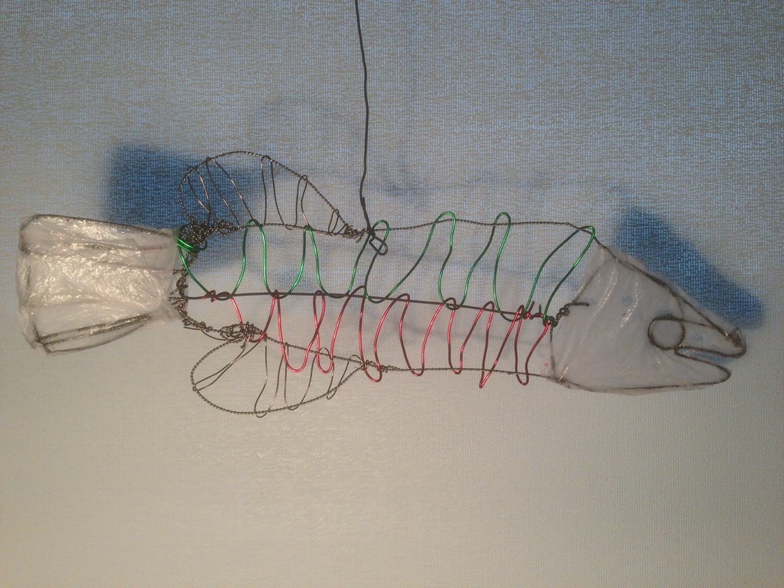
Skill 4: Joining and Combining
continued
There are lots of lovely sewing activities you can incorporate at all ages of course and they overlap with Design Technology requirements too, so they are great to do.
My older pupils would make puppets, the younger ones might make simple motifs such as flowers, animals or faces and TTS have some great starter packs that can get you started.
Weaving is also an essential Art/DT activity. It’s easy enough to do at all ages, and even older pupils enjoy it. I used to do weaving at art college in my teens! There are some great looms, frames, threads, yarns, and ribbons you can buy at TTS.
Wire construction is also a great craft activity that I used to do often. With a few simple instructions on twisting, bending and joining wire you can create a wide array of forms from fish to insects, animals, vehicles, people or buildings. I’d begin with pipe cleaners at first, then move on to aluminium wire with older pupils. You can even cover aluminium wire models with tissue Paper Mache and PVA glue before painting them to create amazing, highly coloured forms.

Slide 9
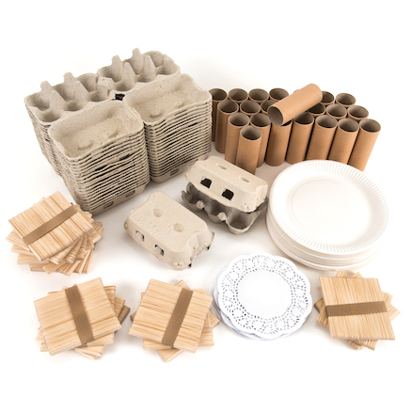
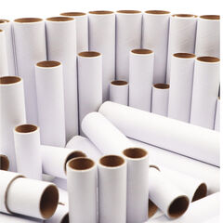
Skill 5: Constructing
Construct - build, strengthen, and assemble
It’s a brilliant idea to keep all the brown cardboard packaging boxes that is delivered into the school because it’s such a super free resource you can use to create models. Alternatively, use grey board. There are some fantastic card sculpture materials at TTS such as craft rolls, egg boxes, cones, shapes, and spools.
You’ll need to teach some basic card construction techniques such as bending, folding, scoring, slotting card at angles, making card cylinders, making tabs, support struts, scrolling etc. Teach a basic skill first, get the pupils to make a demonstration example, then give them an opportunity to creatively apply it. For example, I would provide the pupils with a sheet that contained a few basic techniques, they’d practice them using scrap paper, then they’d design and make a simple card mask that used combinations of the features. They can use glue or masking tape to stick them. Then, they could cover them with Mod Roc. To paint them, you could use acrylic paints, or even strong Brusho inks which give a vibrant effect.

Slide 10
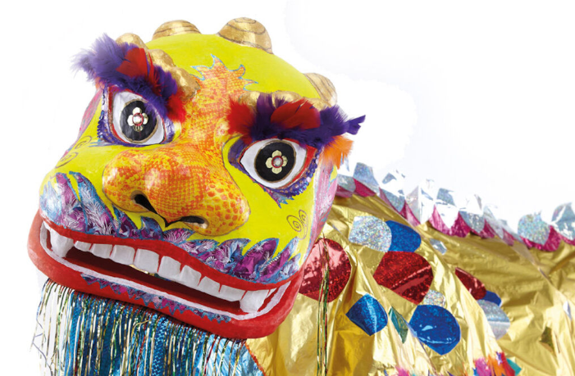
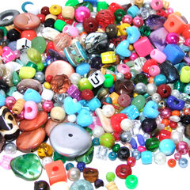
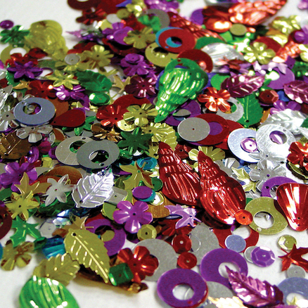
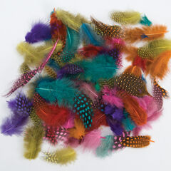
Skill 6: Finishing
Finish - prime, paint, surface, texture, appearance, and decorate.
Finishing is one of those activities that is easy to overlook but, if you do it right, can make all the difference when trying to get high-quality outcomes. If you’re wanting to finish models to a high standard, then you nearly always have to apply a base primer coat first. I would use household white emulsion paint, leave it to dry, then begin applying acrylic paint to finish. I’ll usually apply a base colour first, then add further coats to create details or textures. You might also embellish models further by adding beads, sequins, or feathers etc.

Slide 11
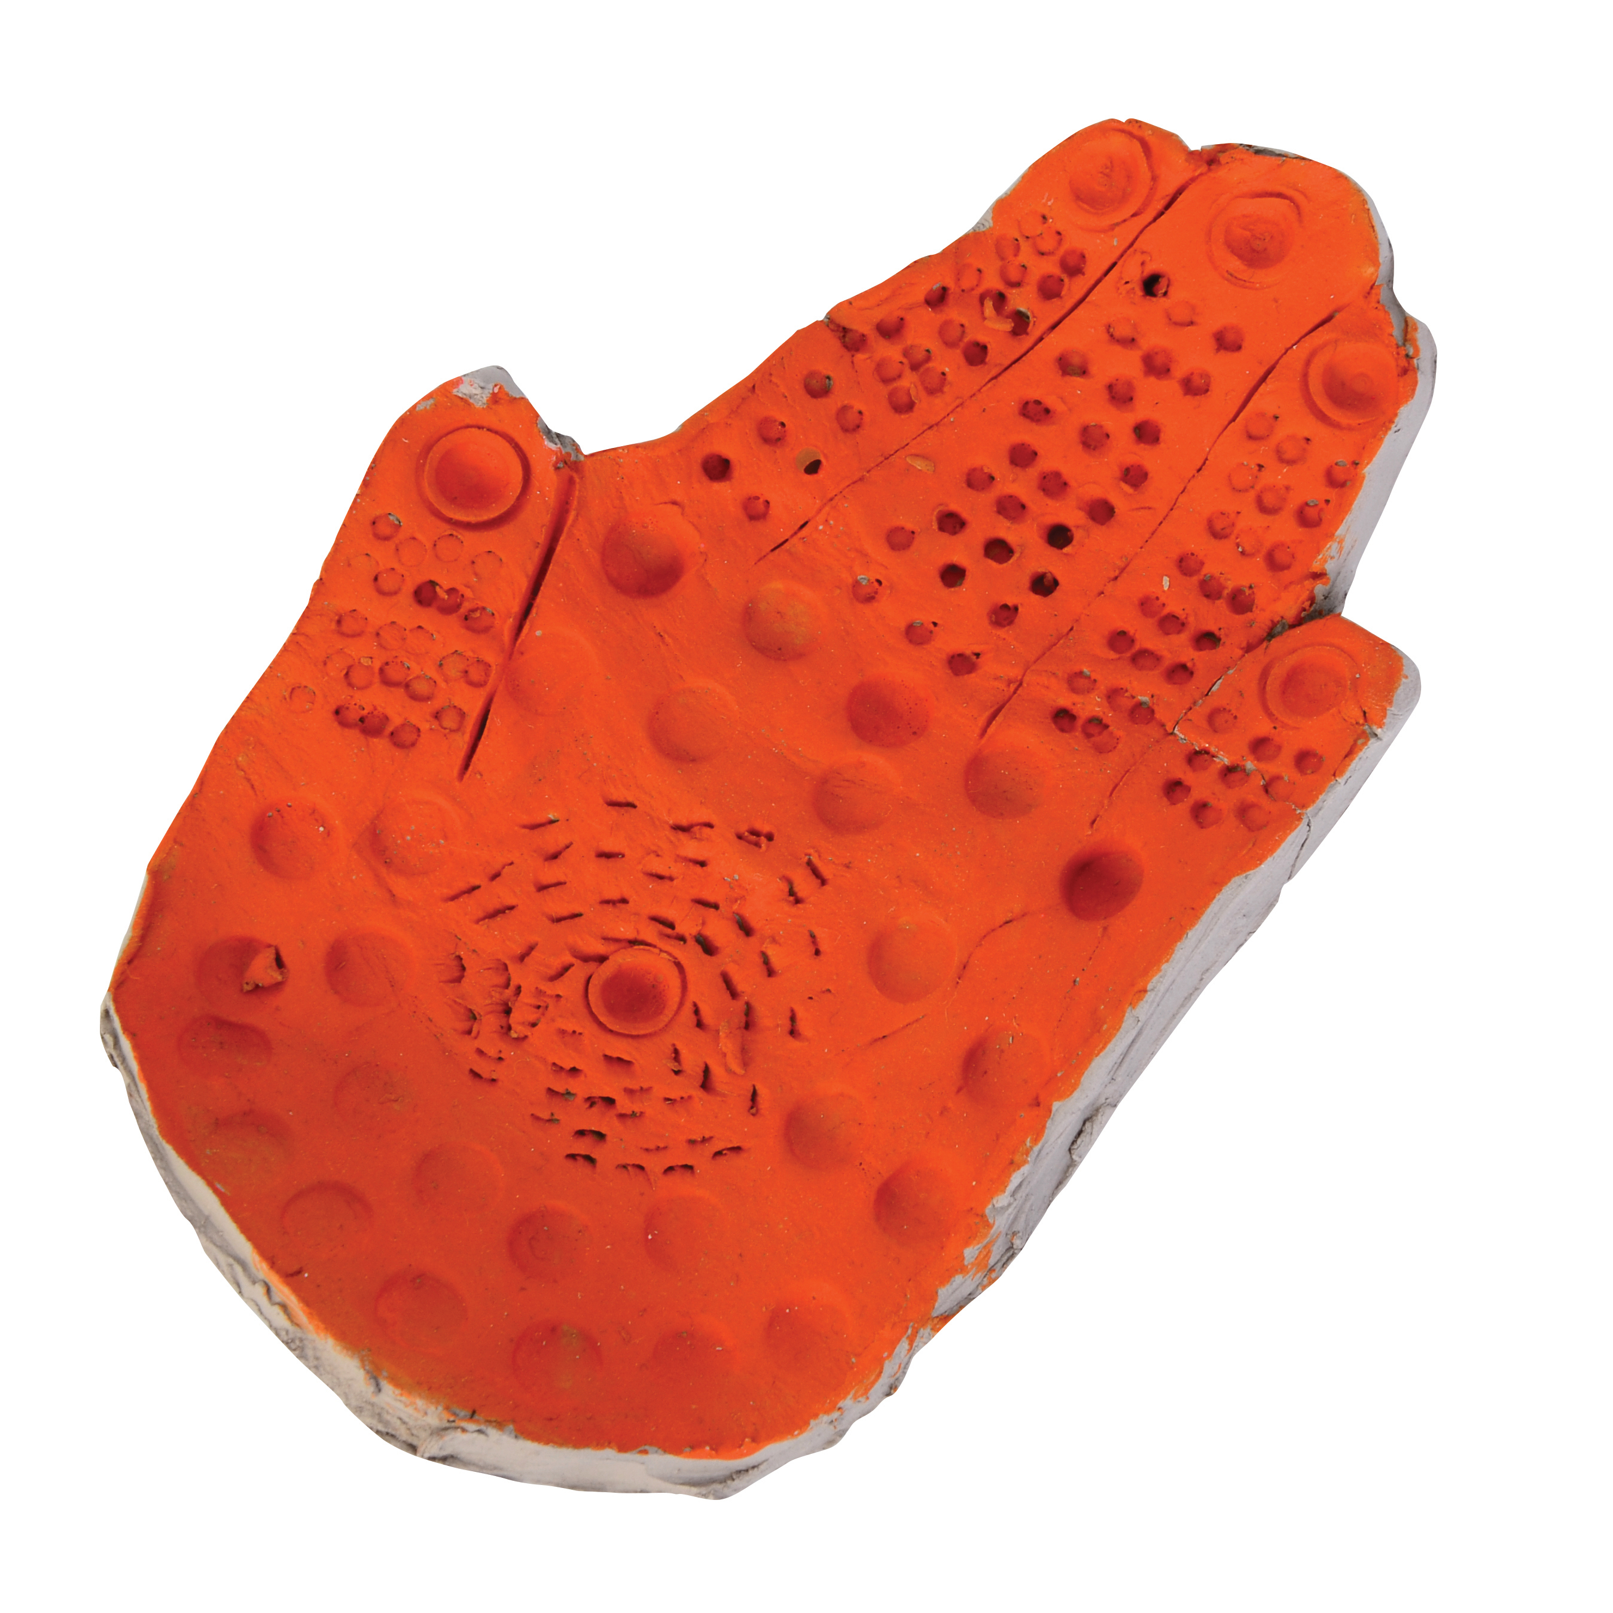
Sculpture
Sculpture
Sculpture is, I think, one of the most rewarding and engaging creative activities we do in school. Yes, it’s specialist, messy, and expensive but it’s also extremely good fun, challenging and complex. It requires pupils to plan, to think in both two and three dimensions, to experiment, to problem solve and collaborate. It develops both our fine and gross motor skills, whilst stimulating our imaginations and creativity. Personally, sculpture was always one of the most exciting activities I used to teach. But it was also one of the best things I did as a student too. Just try to make sure you don’t spend 5 weeks on planning an activity and 1 week making it. Try to just get stuck into making and learn through and within the medium. Your pupils will love you for it and they’ll learn more.
Paul Carney
www.paulcarneyarts.com

Slide 12
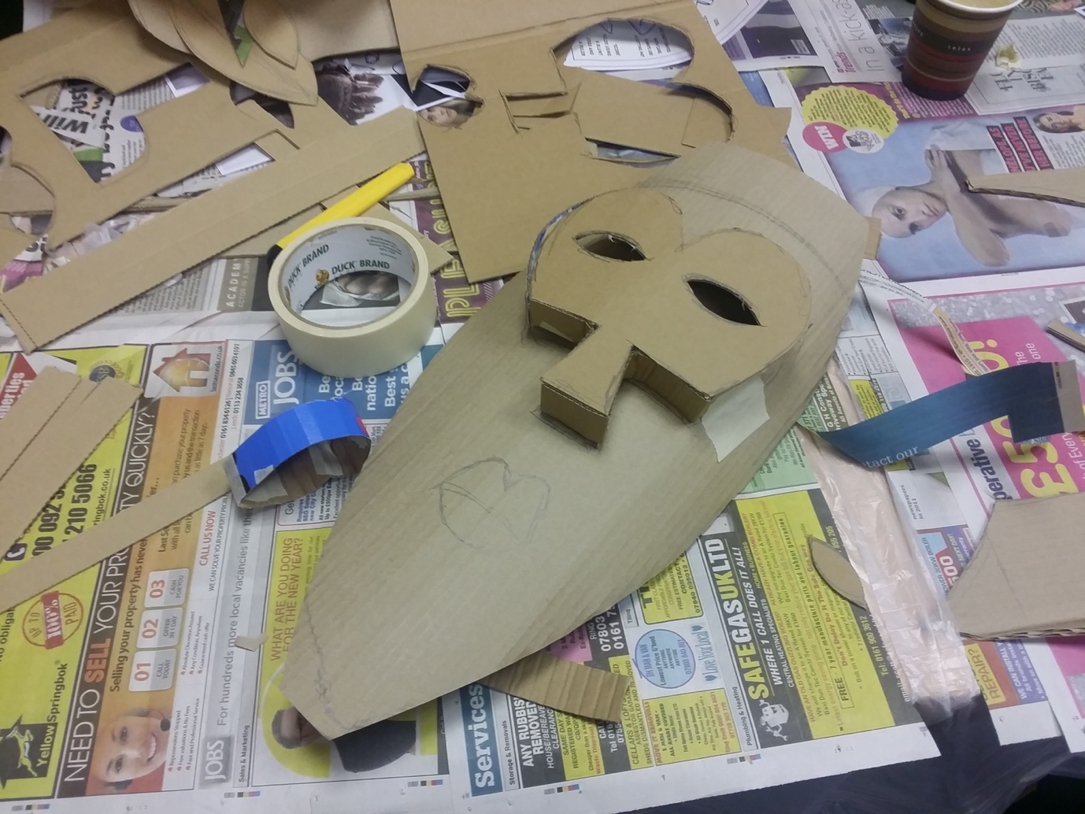
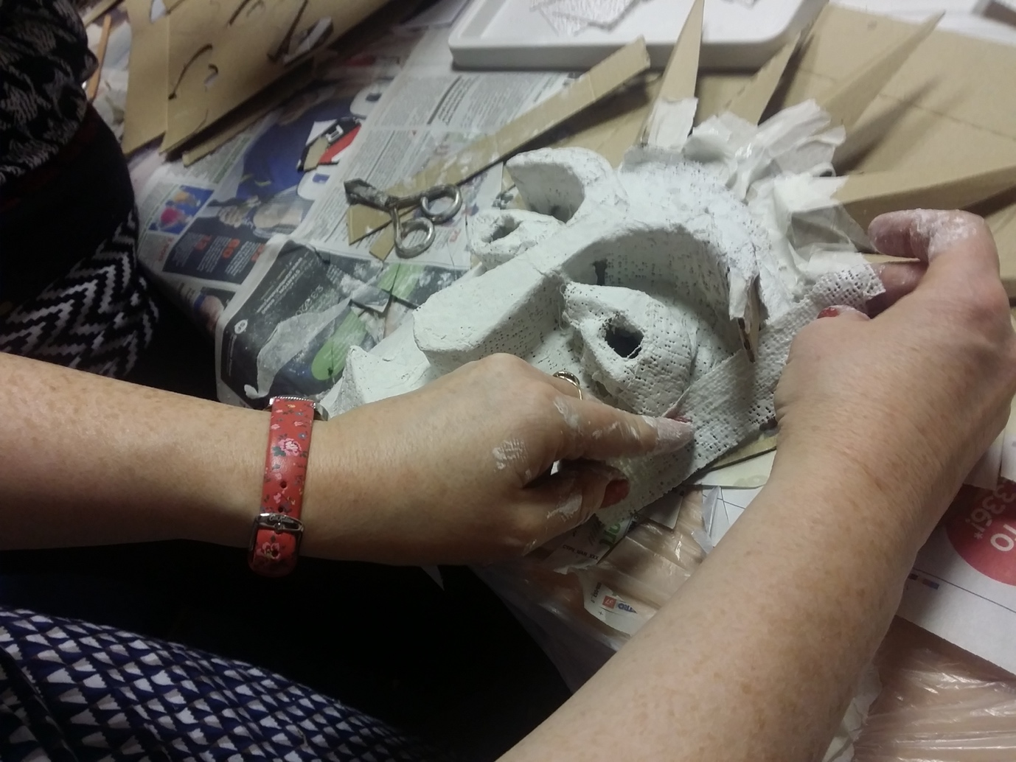
Cardboard, Mod Roc mask
making

Slide 13
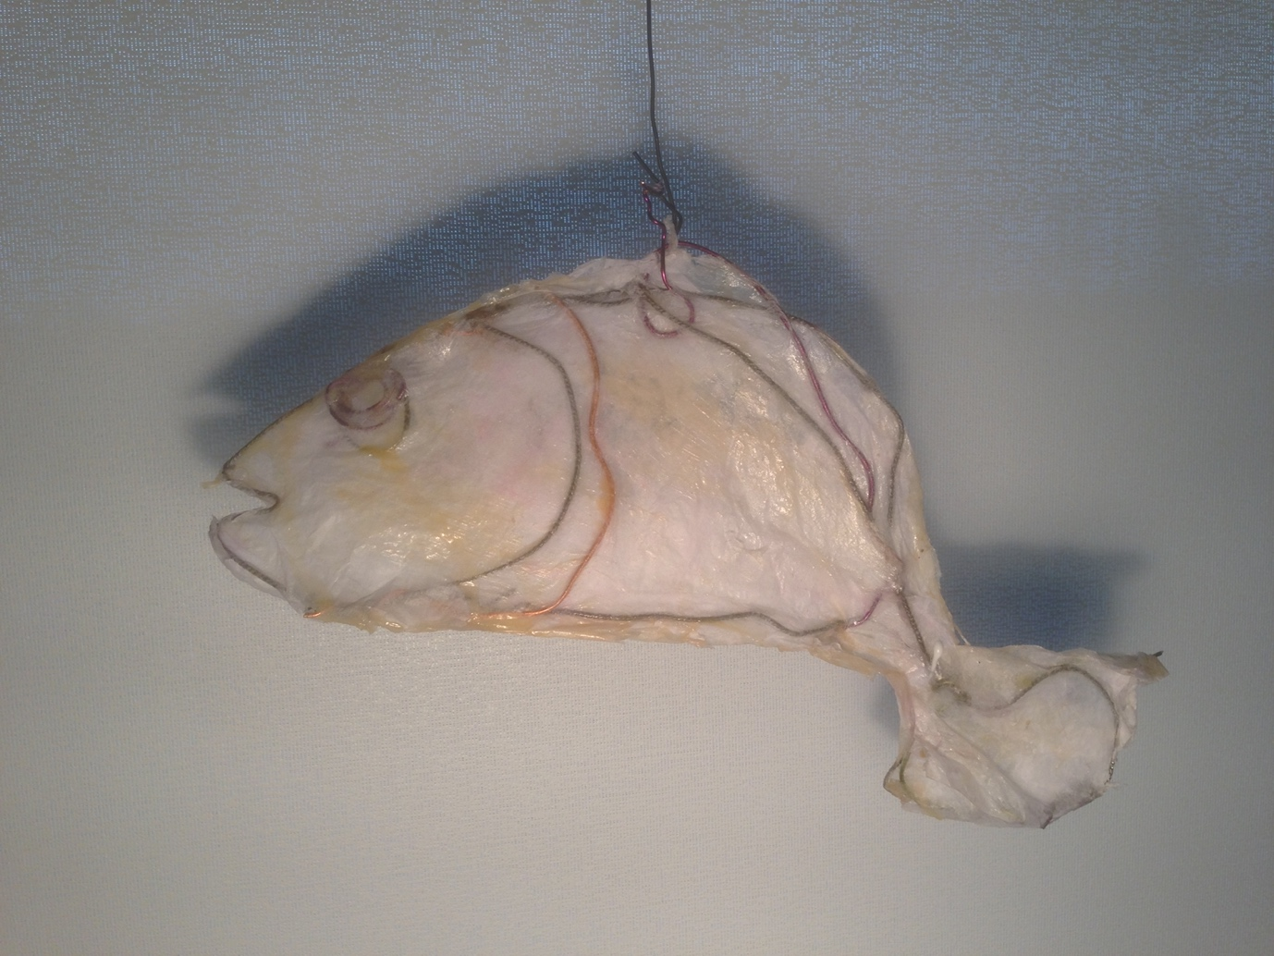
Wire Fish Year 5
Many thanks to Paul Carney
www.paulcarneyarts.com

